Slide 1
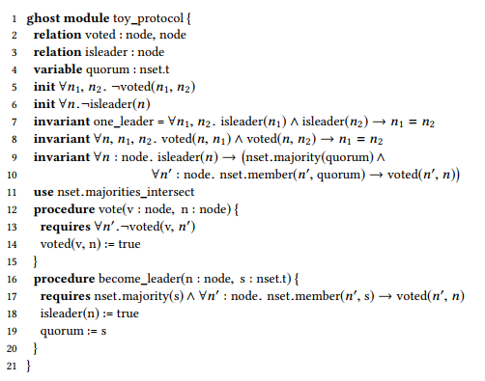
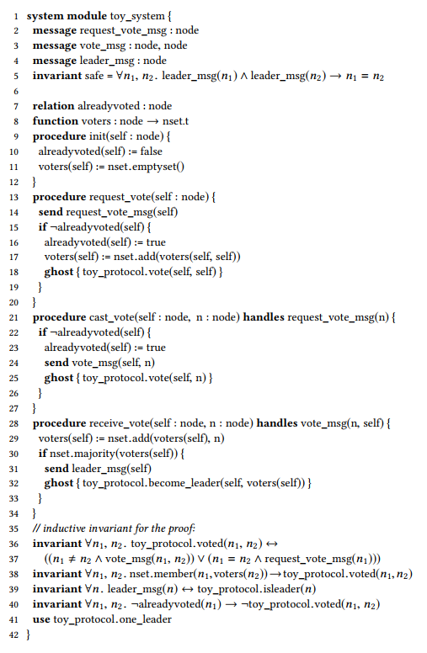
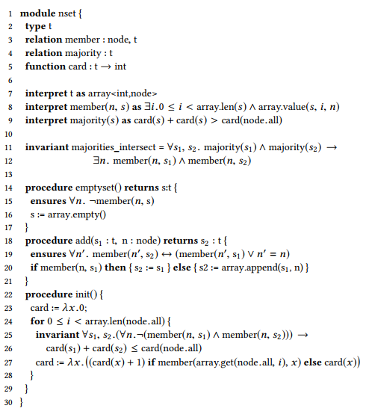

Slide 2
Find out which external functions, procedures and specs are really required to prove the safety formula.
Create an abstract (ghost) module that prove the safety formula (or a corrolary) by only using these elements. Functions can be replaced with relations in order to avoid cycles.
Specify the abstract module by translating the original procedures to abstract ones.
Update the original module to use the abstract module.

